Slide 1
PLC programming using Studio 5000

Slide 2
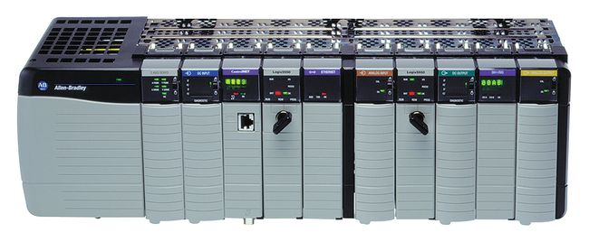
What are PLCs?
Programmable Logic Controllers (PLCs) were developed due to the need of reconfiguration in automotive manufacturing, which relied on wiring and relay-based control systems.
PLCs are used not only in the automotive industry, but also in petroleum and chemical plants, CNC manufacturing, and more.
There are many brands of PLCs. They are programmed with languages standardized in IEC 61131-3. One of those languages is ladder logic.

Slide 3
PLC components
Backplane
Power supply
Slot [0] : CPU
Slots [1:n] : I/O section

Slide 4
PLC components
CPU: Main control center that evaluates the logic and changes outputs every 5 to 50 ms.
Power supply: Supplies the power for the CPU and I/O sections.
Programming interface device: A computer used to write a ladder program that has the capability to download (send to PLC), upload (read from PLC) or go online and monitor. The application software for programming is Studio 5000.
I/O modules: Work with voltages higher than the CPU can handle. These modules “isolate” the PLC and protect its circuits.

Slide 5
Addressing, memory, and scan routine
Addressing tells the PLC what to look for and send out. Addressing involves three parts: a) Data type (e.g., “I” for input and “O” for output) b) Module location (e.g., 1 is for slot 1) c) Specific terminal (e.g., terminal 0) Example: I:1/0 refers to the input from slot 1 terminal 0.

Slide 6






Basic ladder logic
Examine-if-closed (XIC) Examines a bit for an ON condition Uses: start push buttons, limit switches, lights, internal bits
Output latch (OTL) Turns a bit ON when the rung condition is TRUE, and this bit retains its state hen the rung is not executed.
Examine-if-open (XIO) Examines a bit for an OFF condition Uses: e-stops, and same as XIC
Output unlatch (OTU) Turns a bit OFF when the rung condition is TRUE, and this bit retains its state hen the rung is not executed.
Output energize (OTE) Turns a bit ON or OFF Use OTE to turn a bit when rung condition is TRUE Uses: light, motor run signal, internal bits
One-shot rising (OSR) Triggers a one-time event.

Slide 7
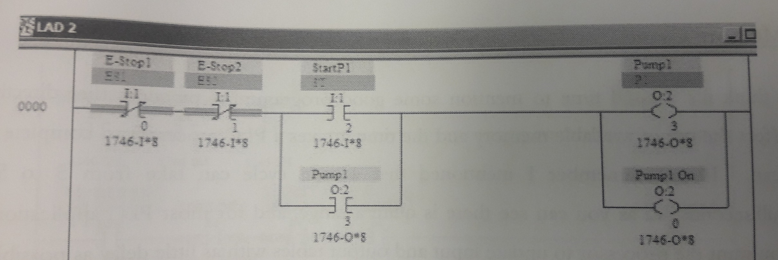
Basic ladder example
As long as the e-stops are not pushed, the systems waits for the start push button to turn ON pump 1. Note that this rung latches pump1 because as long as pump1 is ON, this rung will be TRUE even after releasing StartP1.

Slide 8
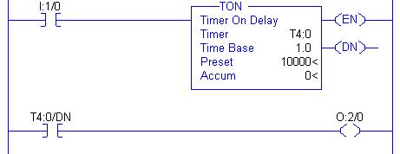

Timers and counters
The TON or “on-delay” timer is enabled when rung conditions are true (one can check the enabler with the EN bit). The “done bit” DN is set to 1 when the counter finishes its count.
The TOF or “off-delay” timer is enabled when rung conditions are false. The “done bit” DN is set to 0 when the counter finishes its count.

